Slide 1
Posterization with Image Segmentation
Lucas Liu

Slide 2
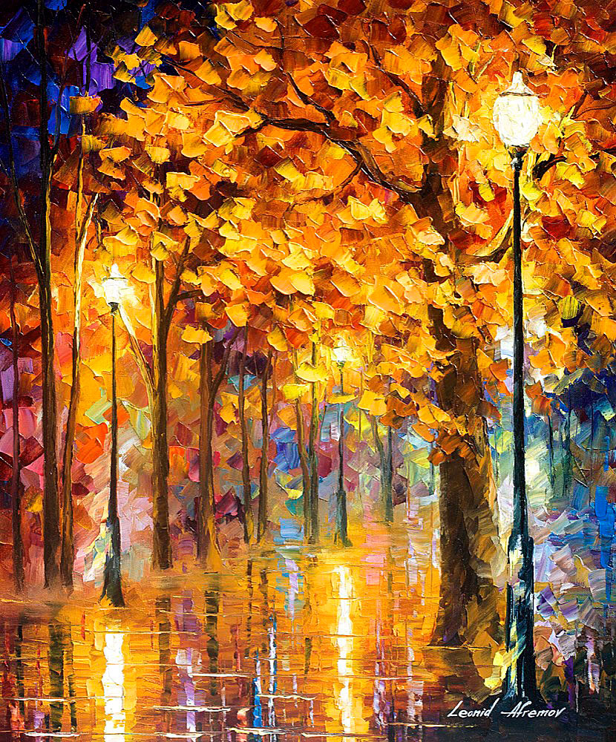
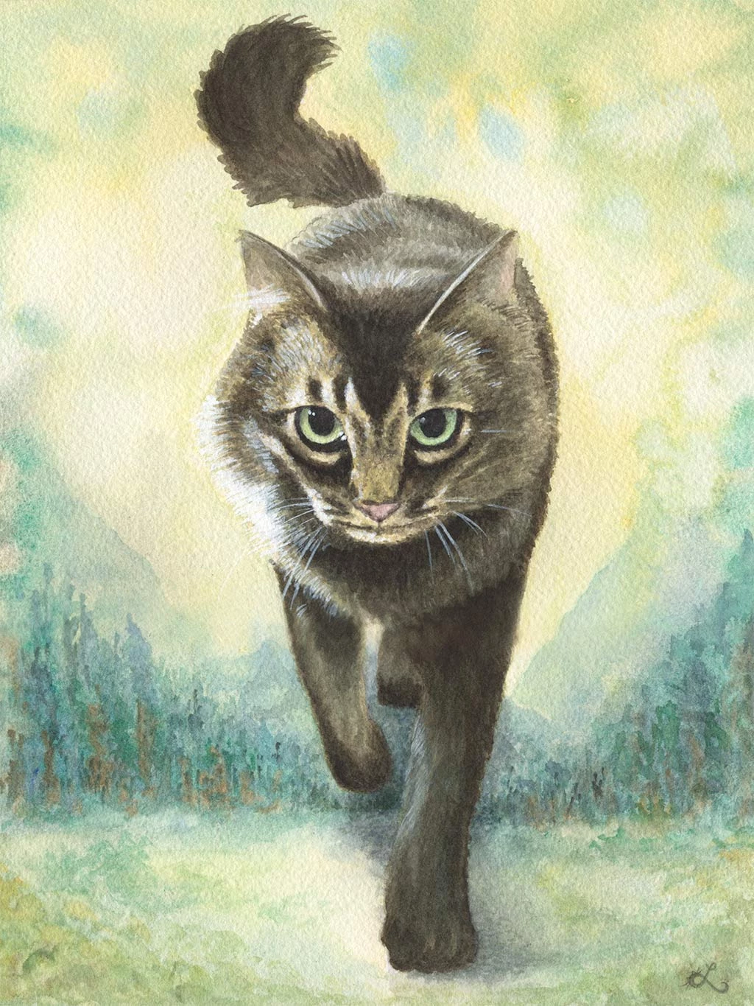
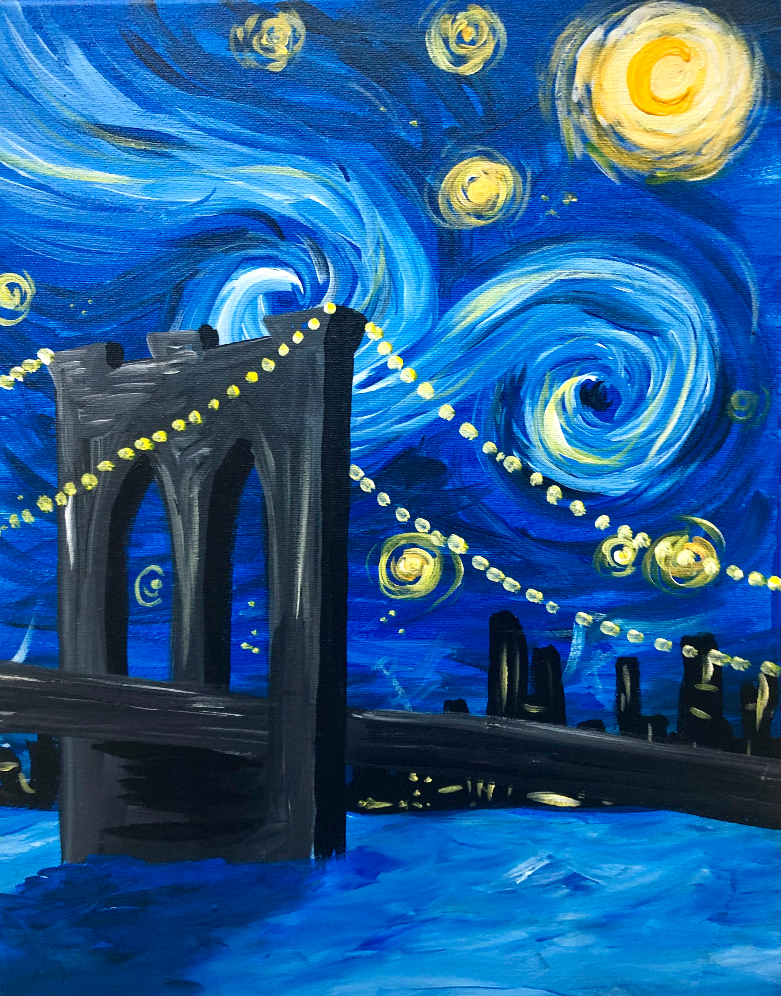
Conjecture
Artists like to discretize the environment into individual objects.
Each of these objects is then painted independently.
Some large objects may even be represented using discrete sub-objects
A face is eyes, nose, mouth and ears

Slide 3
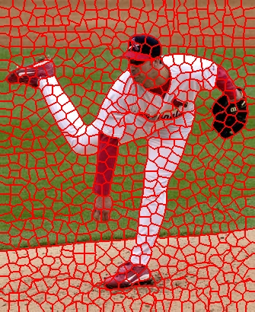
Hypothesis
Suppose we segment an image into masks that each describe a locally similar image region.
If we identify a color palette for each one of these masked objects and posterize them, then we will have a more aesthetic image that has a “painterly” quality.

Slide 4
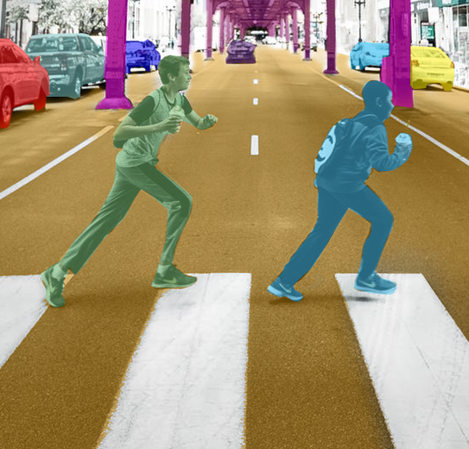
Approach - Segmentation
There are 4 unsupervised image segmentation techniques tested:
SLIC
Felzenswalb
Quickshift
Chan-Vese
Each of these take in an input image and produce a new array of the same shape whose value at each index is an ID corresponding to the pixel’s assignment
Before these segments are computed, the input is first converted to LAB and is blurred with a Gaussian filter.

Slide 5
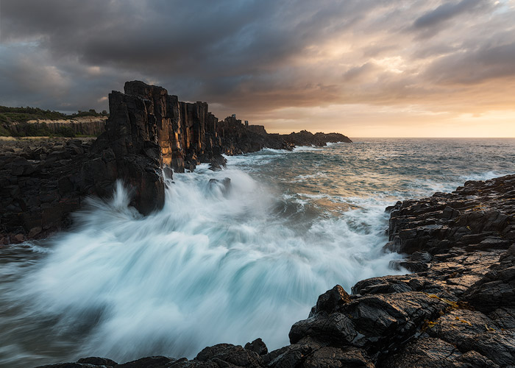

Approach – Posterization
Because the segmentation approaches default to LAB, I begin posterization by taking the RGB values for all pixels contained within a region and convert them to LAB.
Then, I apply K-means clustering to identify the cluster centers of this array of pixel values to obtain dominant colors in each region.
Each pixel is assigned to some cluster, or some color, and has its color value replaced with that of a cluster center.

Slide 6
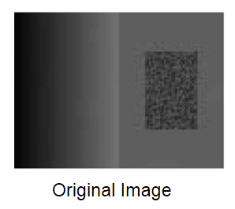
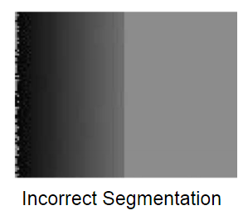
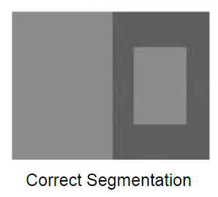
Felzenszwalb Segmentation
Main Problem: some objects are “noisy” in their texture, leading to incorrect segmentation.
Approach: uses a graph based representation in which each region is a node connected to other regions/nodes with some edge.
Edge weight proportional to amount of differentiation
Basic idea: if the difference between two component is of some threshold T greater than the internal differences of the components (intensity), then there exists a boundary.
The implementation is similar to Kruskal’s MST algorithm, by finding connected subcomponents that minimize edge weight within.
Key property: all pixels of the same region are physically connected to each other.
Main tweaking parameter:
Scale parameter = how much “attention to detail”

Slide 7
Felzenszwalb Examples

Slide 8
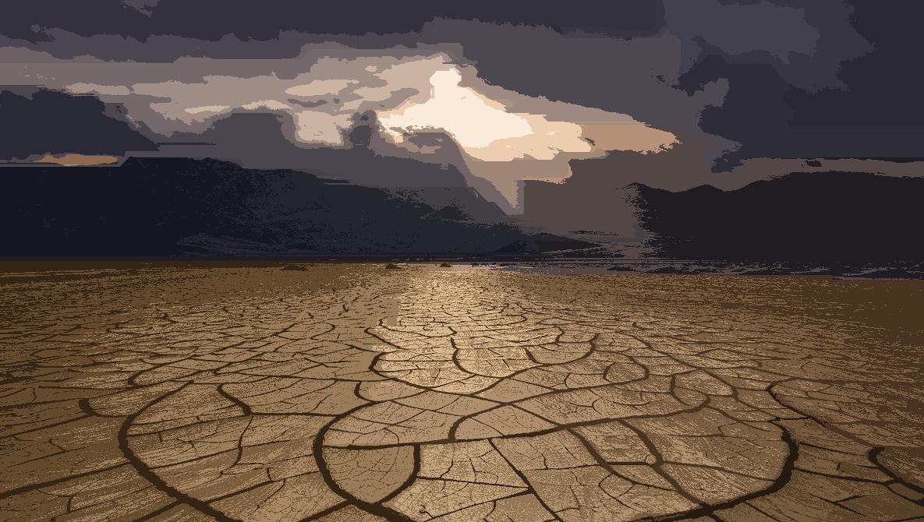

Slide 9
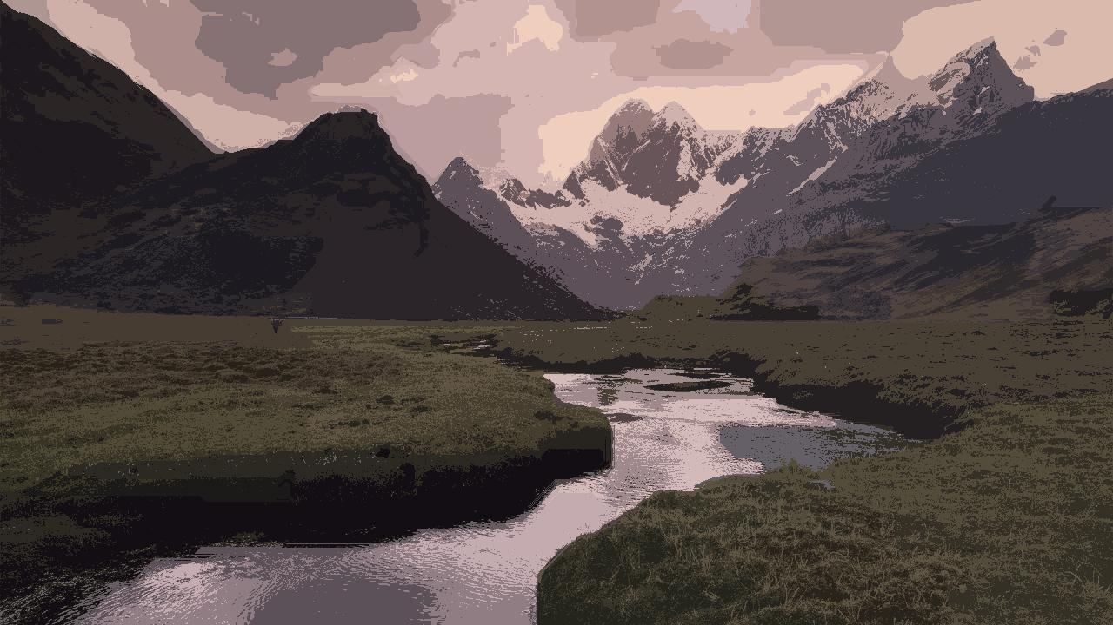

Slide 10
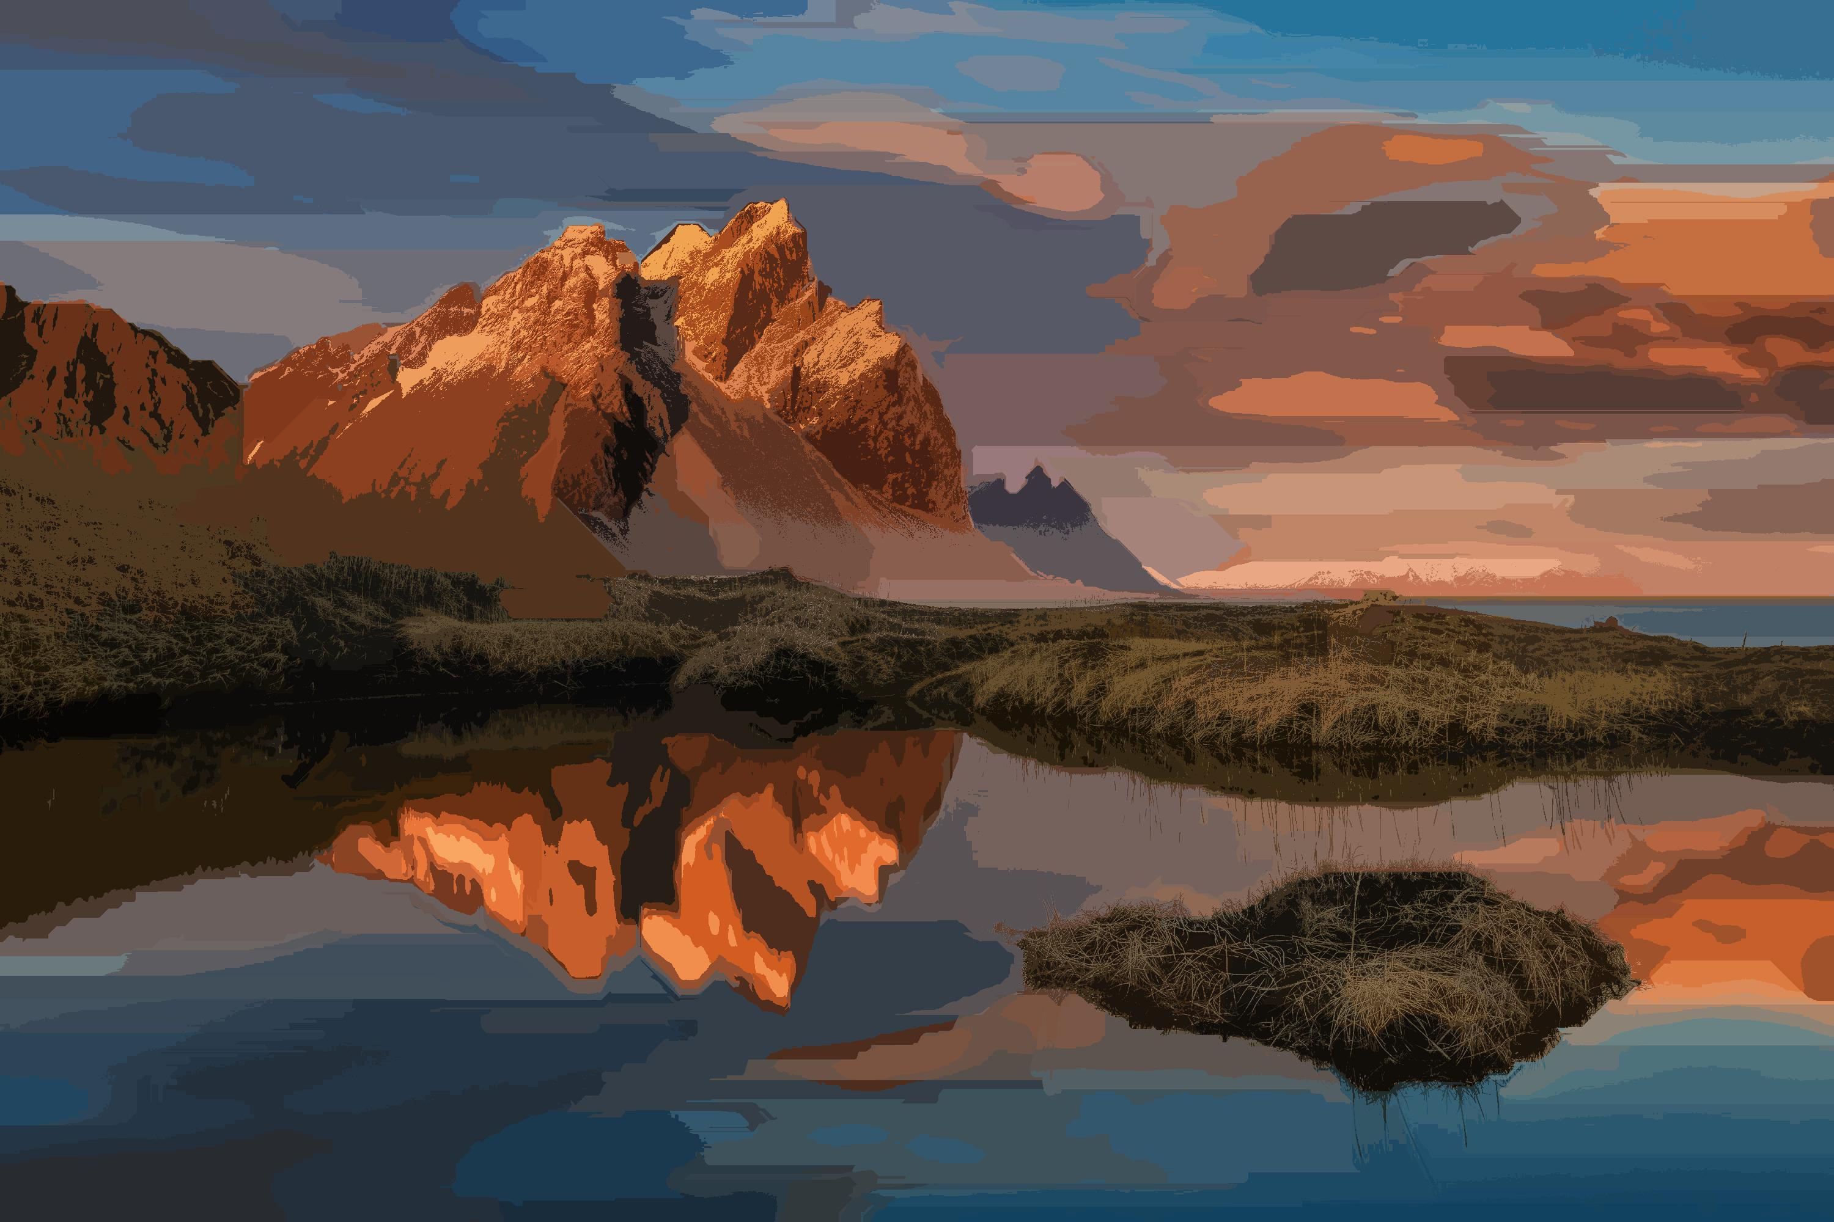

Slide 11
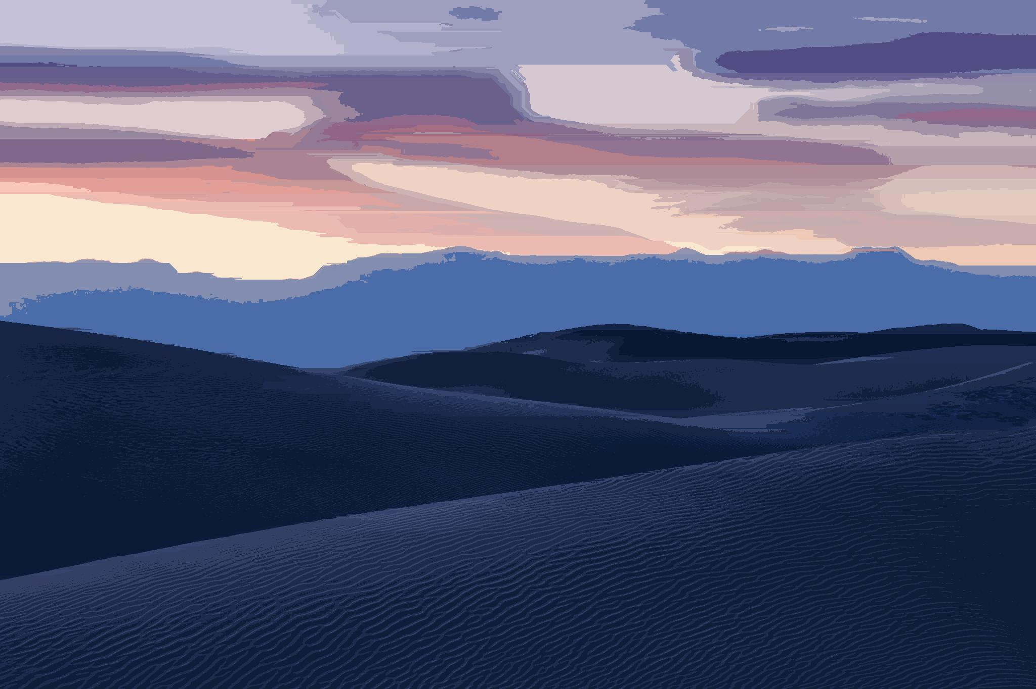

Slide 12
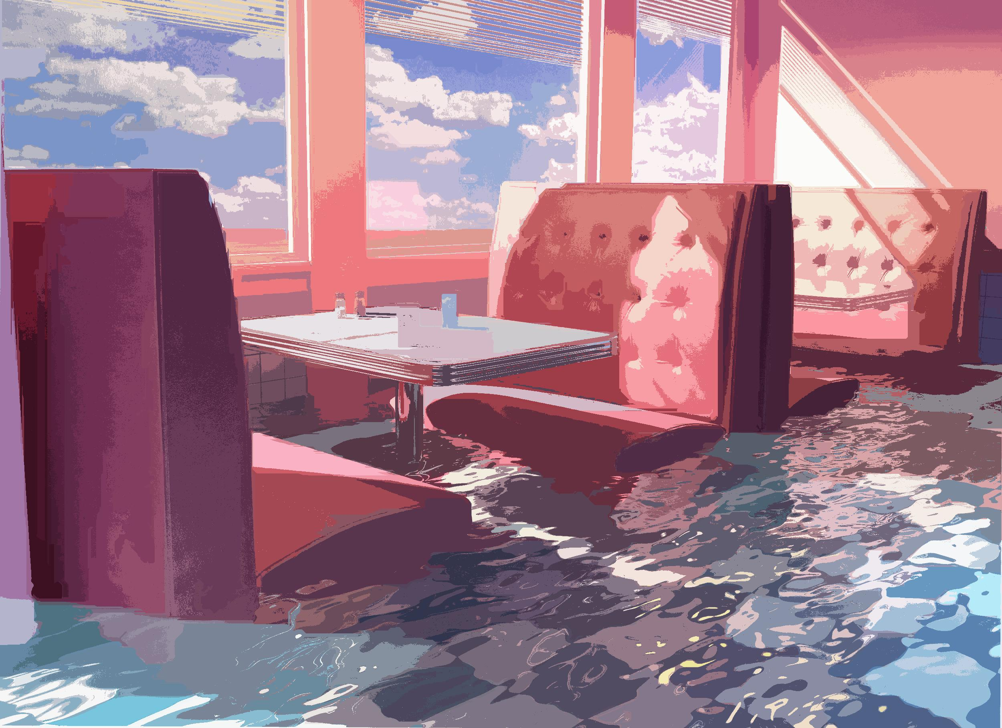

Slide 13
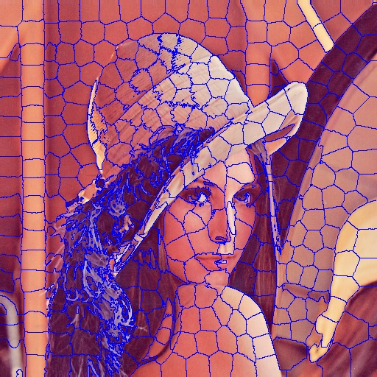
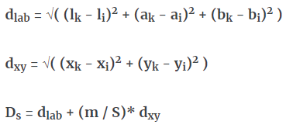
SLIC Segmentation
Main Problem: computing regions of pixels that are locally similar (color and location) to form “superpixels”
Convert image to LAB space and concatenate its values with XY coordinates for a 5d feature vector per pixel.
Use K-means clustering with an alternative composite distance function
M = weighting of color vs position
Main tweaking parameter
Roundness of pixels (how spheroid they are)
M

Slide 14
SLIC Examples

Slide 15
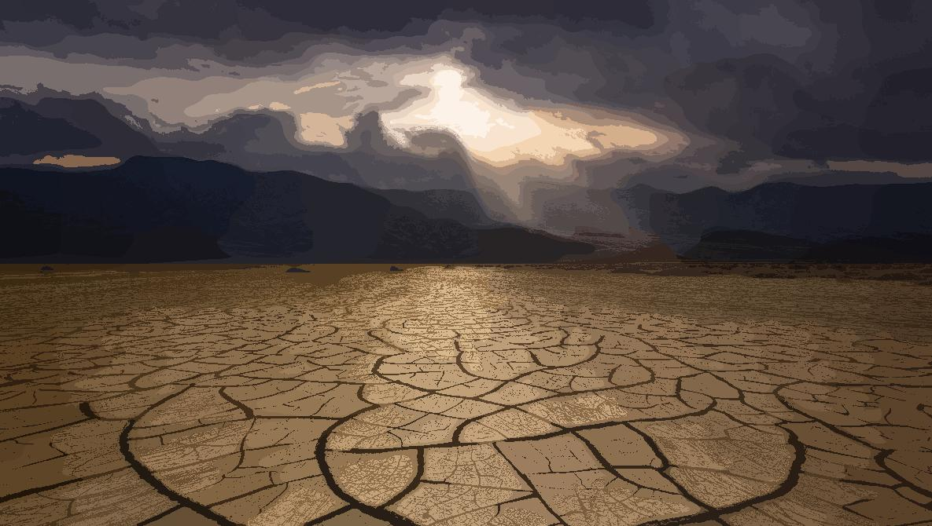

Slide 16
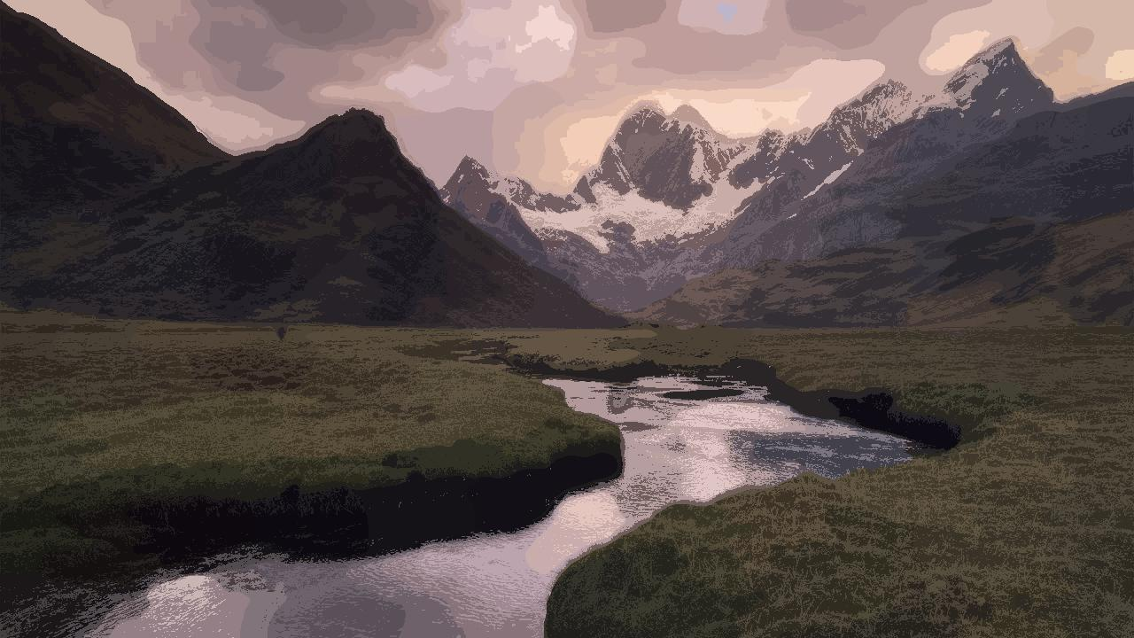

Slide 17
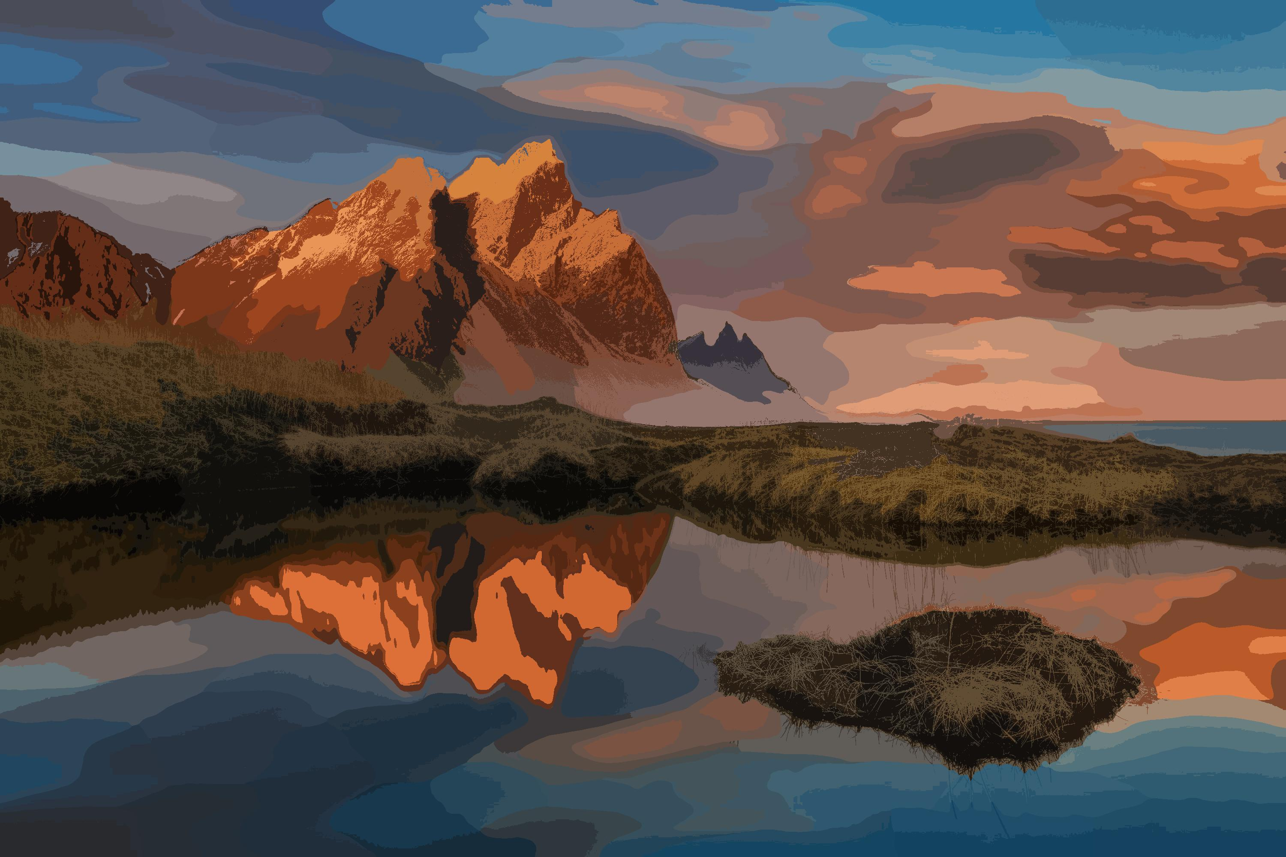

Slide 18
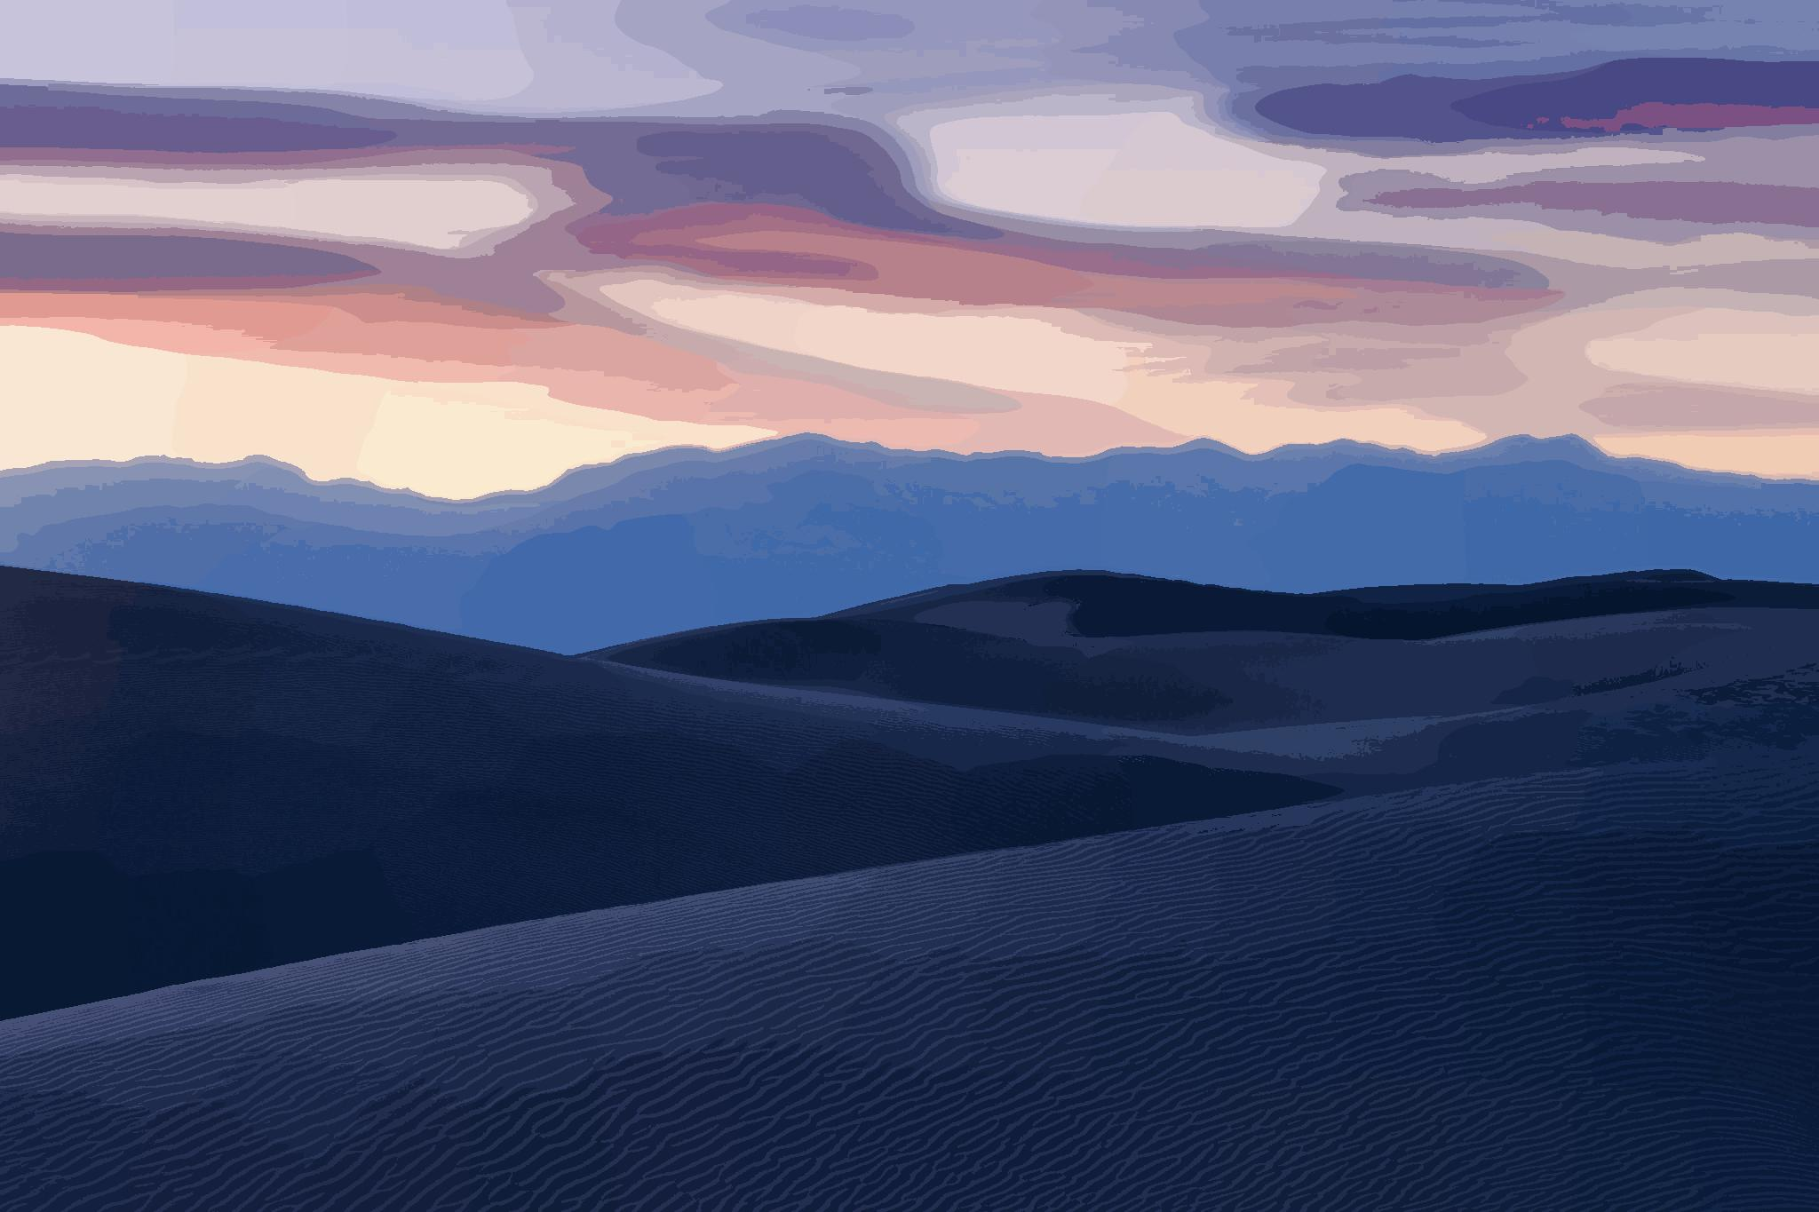

Slide 19
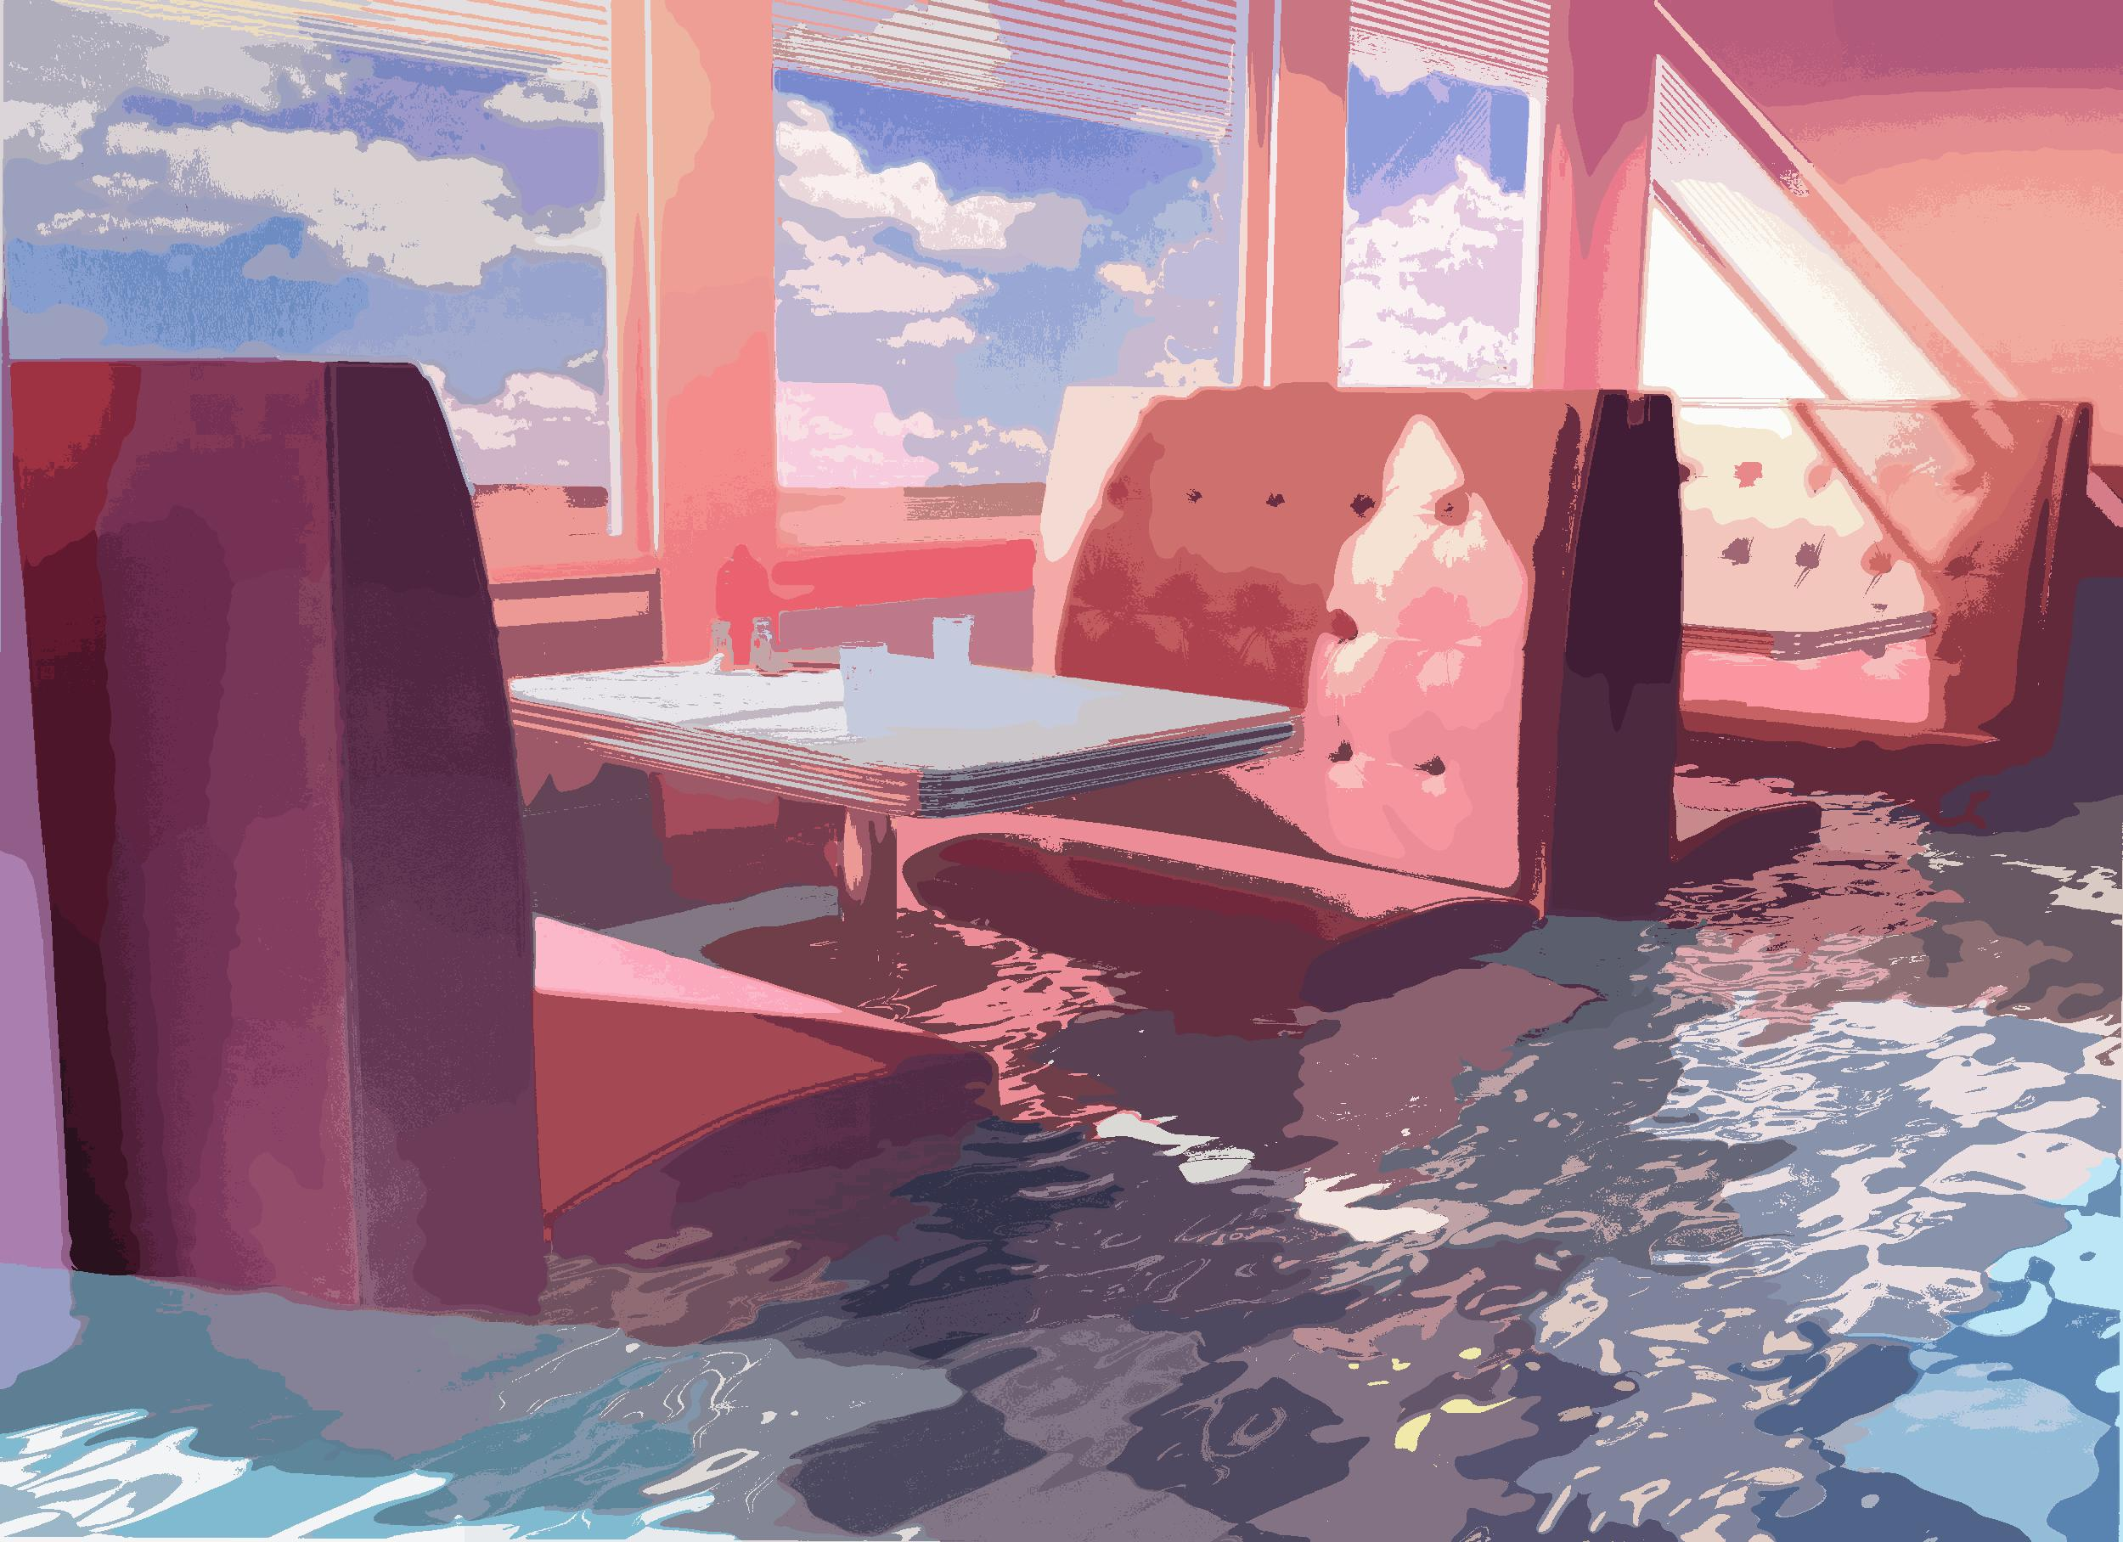

Slide 20
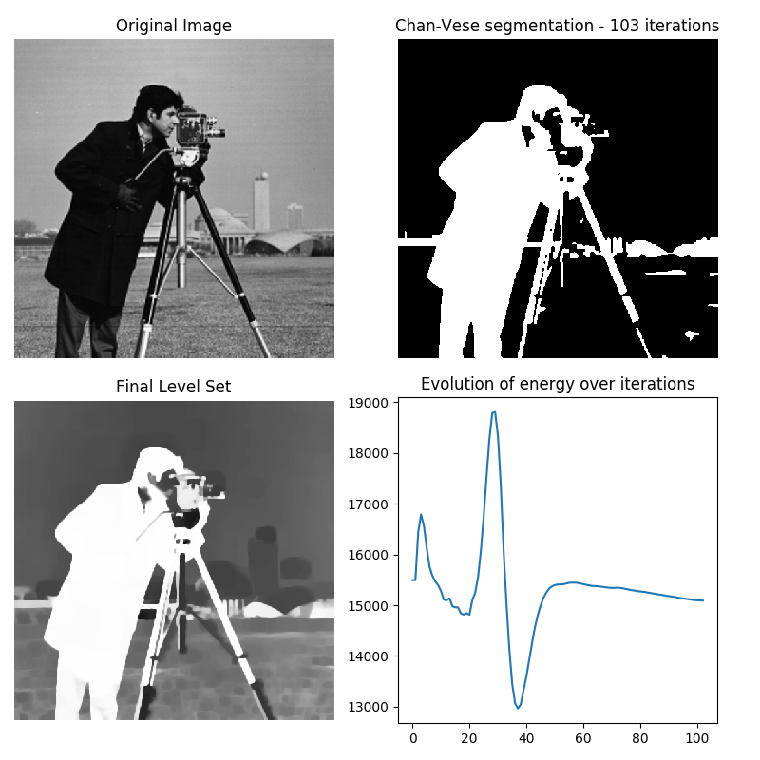
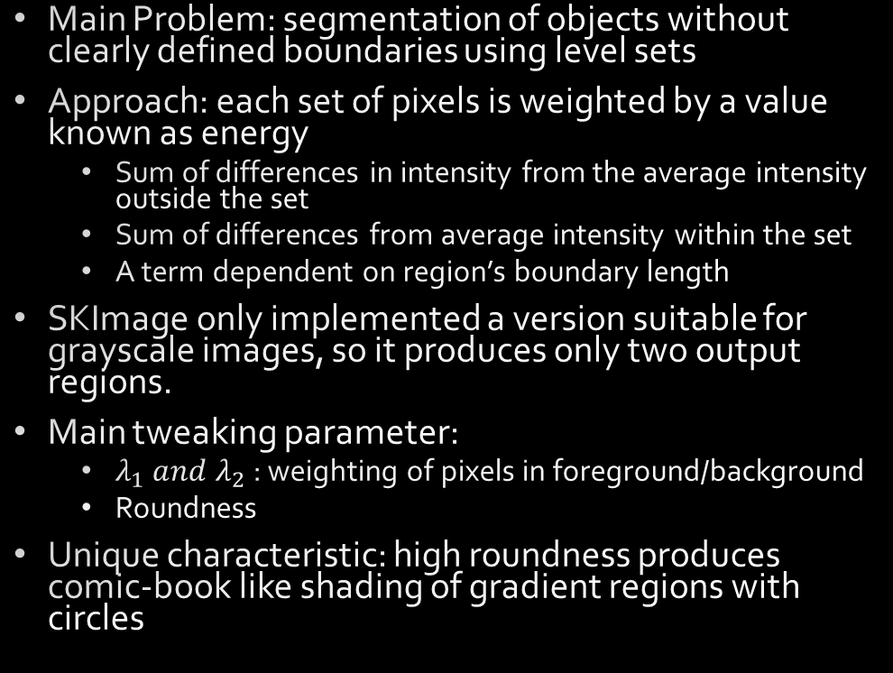
Chan-Vese
Main Problem: segmentation of objects without clearly defined boundaries using level sets
Approach: each set of pixels is weighted by a value known as energy
Sum of differences in intensity from the average intensity outside the set
Sum of differences from average intensity within the set
A term dependent on region’s boundary length
SKImage only implemented a version suitable for grayscale images, so it produces only two output regions.
Main tweaking parameter:
$λ_{1} and λ_{2}$ : weighting of pixels in foreground/background
Roundness
Unique characteristic: high roundness produces comic-book like shading of gradient regions with circles

Slide 22


Slide 23
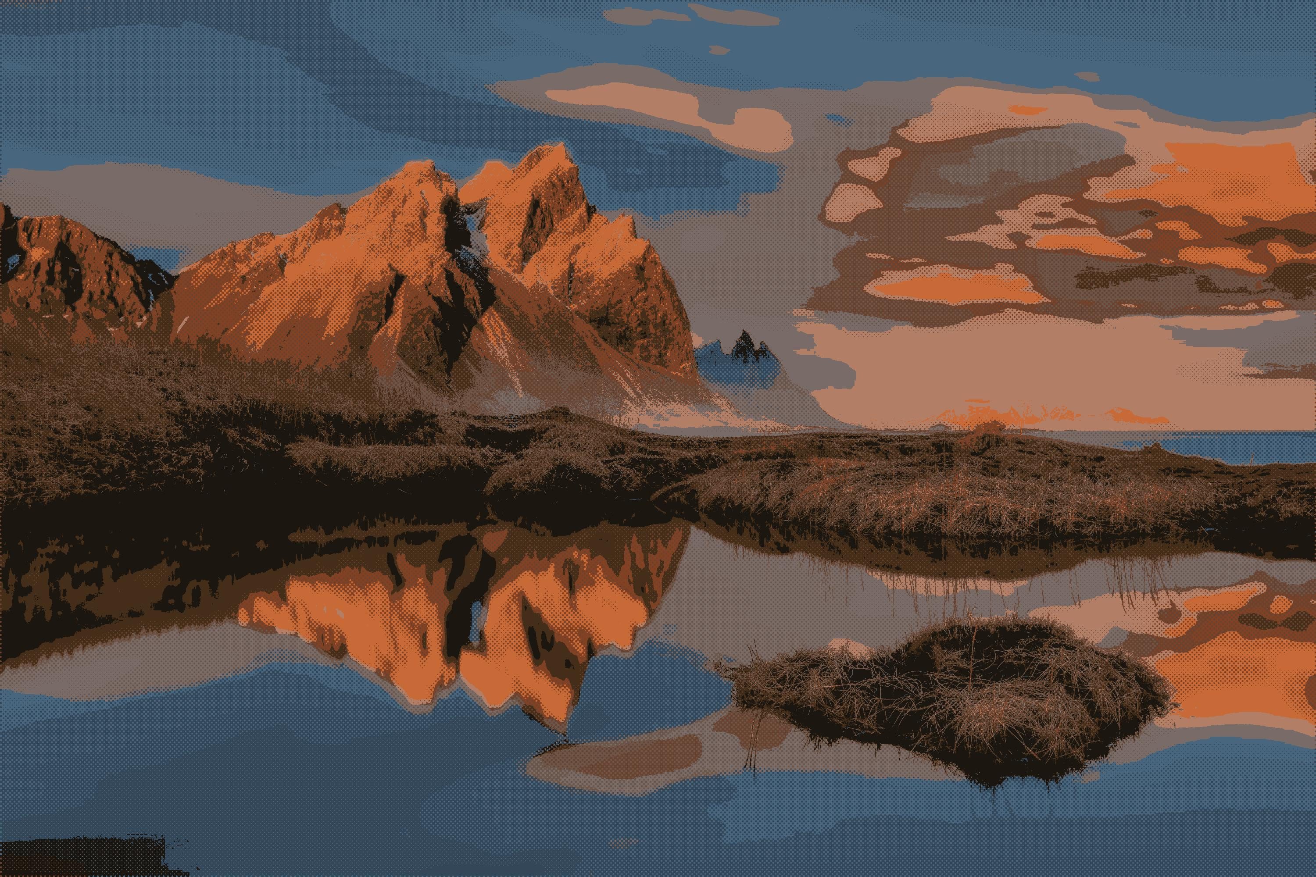

Slide 24
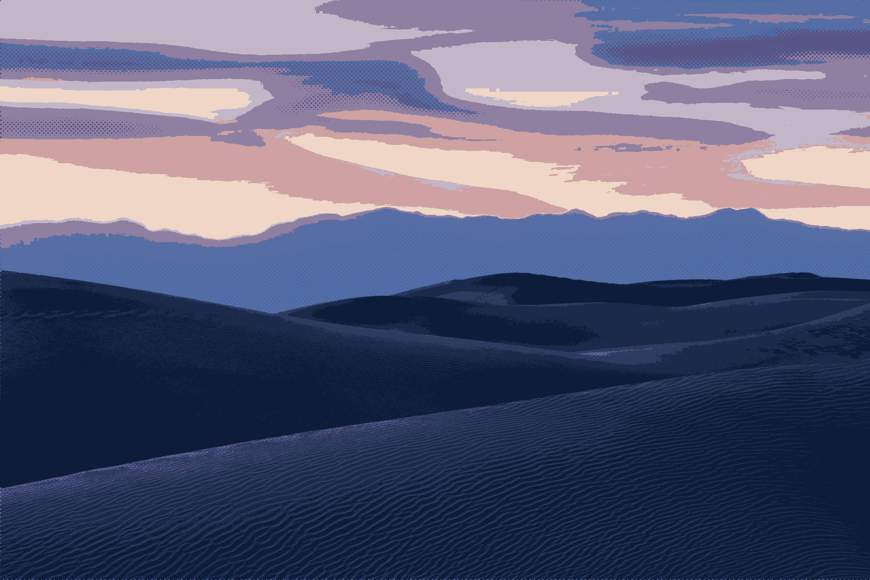

Slide 25
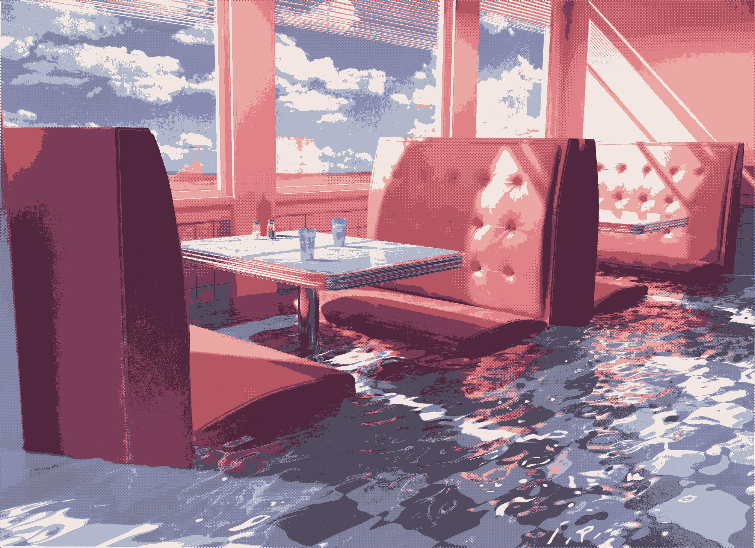

Slide 26
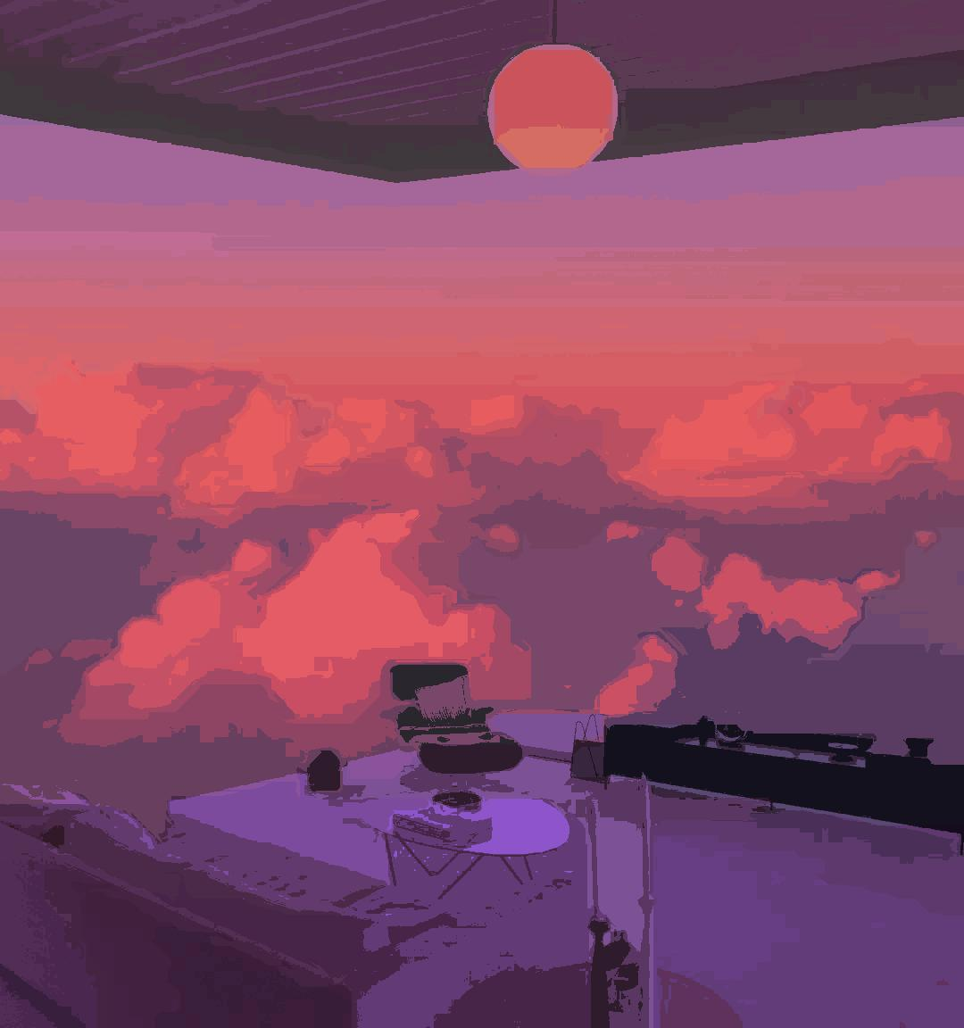
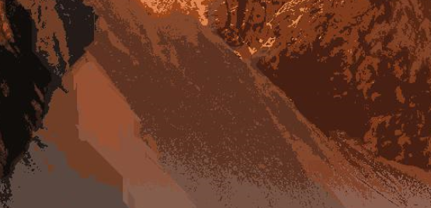
Limitations and Future Work
Each of these segmentation methods have many parameters that all affect the final outcome quite drastically.
Need some way to automatically determine best parameters with heuristics
Many output images have harsh noisy boundaries between regions.
Gaussian blur pre-processing breaks Felzenszwalb by making thresholds harder to compute.
Gaussian blur post-processing makes “clean” regions lose definition

